Slide 1
Online Blood Donation and Request Management System
Group No-42

Slide 2
Project Members Details
Member 1: Bhatt om(23CI2010006)
Member 2: Solanki Shailesh(23CI2010192)
Member 3: Patel Akash(23CI2010065)
Member 4: Prajapati Harshil(23CI2010159)
Internal Guide: Nehal Adhvariya

Slide 3

Project Description
Connects donors and requester
Search by blood group and location
Post urgent requests
Real-time availability & admin verification

Slide 4
Proposed System-
The proposed system is an online web and mobile-friendly platform designed to connect blood donors and requester efficiently. It allows users to register as donors or requestors, search for available donors based on blood group and location, and post urgent blood requests. The system aims to automate and streamline the blood donation process with real-time tracking, notification alerts, and admin management features. This ensures faster response, improved availability, and better coordination during emergencies

Slide 5



Technology To Be Used
Frontend
Backend
Database
HTML, CSS, JavaScript, Bootstrap
PHP / Python
MySQL ,
SQLite

Slide 6
Core Features
- User Login (Donor, Requester, Admin)
- Search donors by group & location
- Post blood requests (with urgency flag)
- Admin management panel
- Notification system
- Mobile responsive design

Slide 7
Objectives
Make blood accessible for emergencies
Simplify donor search and request manage
Secure and reliable platform
Raise awareness and encourage donation

Slide 8
Mission
Vision
To provide a fast, reliable, and user-friendly digital platform that connects voluntary blood donors with those in urgent need, ensuring timely availability of blood and saving lives.
To create a nationwide digital ecosystem where no life is lost due to the unavailability of blood by making blood donation and request processes seamless, transparent, and accessible to all

Slide 9
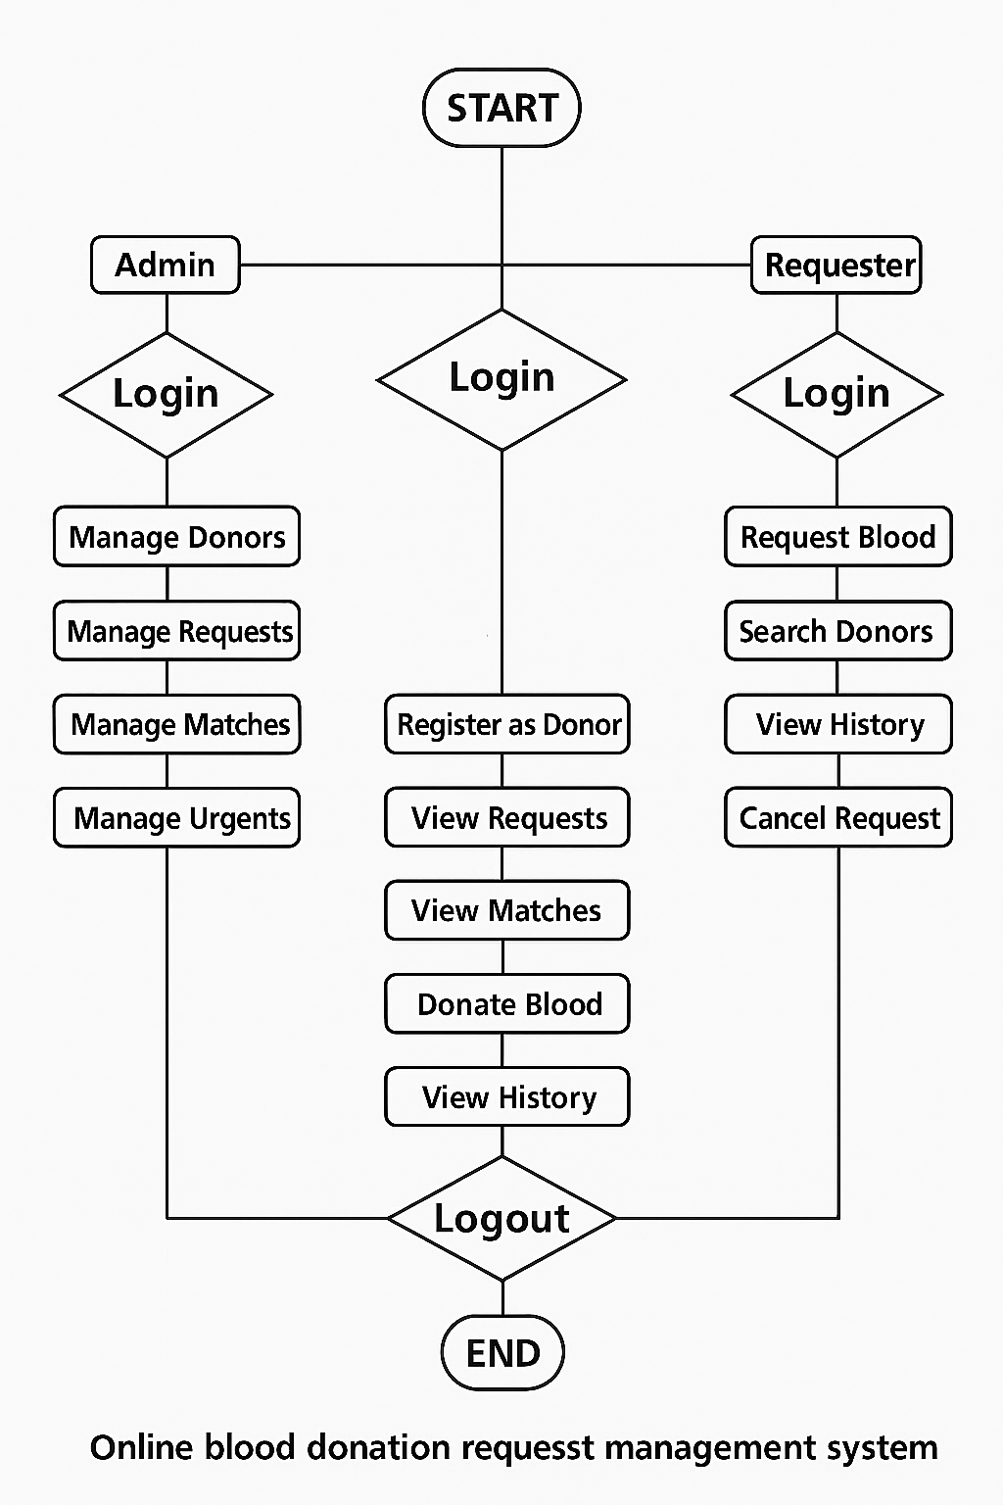
System Flow Diagram
Donor

Slide 10
Thank You

